Slide 1
State Board of Finance Investment Operation and Returns 4th Quarter FY2020
Dennis Milligan
Arkansas Treasurer of State
Notes:
State Board of Finance Investment Operation and Returns, 3rd Quarter - 2019

Slide 2
Treasury Portfolio Allocation *as of June 30, 2020

Slide 3
Short-Term Investment Revenue, Receipted 4th Quarter FY 2020
$ 736,222.14
$ 529,072.05
$ 511,065.93
$ 419,597.89
$ 38,291.65
$ 95,706.89
$ 316,624.25
$ 490,780.40
$ 415,359.04

Slide 4
Long-Term Investment Revenue, Receipted 4th Quarter FY 2020
$4,590,795.63
$ 3,985,412.85
$ 79,098.31
$ 618,686.29
$ 745,489.30
$ 2,155,006.38
$ 1,070,755.20
$ 31,887.15
$ 14,815.59 - Agencies
$ 3,239,923.55
$1,738,004.65
$ 1,024,052.46

Slide 5
Total Revenue per Quarter FY 16 – FY 20
Notes:
Fiscal Year 2016 through fiscal year 2019 quarterly total revenue comparison.

Slide 6
Historical Timeline FY 2010-2020
Total Revenue, All Sources, Receipted
Revenue in USD - Millions
$22.31
Notes:
Comparison of total receipted revenue from FY 2005 to FY 2019, reported yearly.

Slide 7
Money Management Earnings / Return on Investment FY17- FY20
Notes:
Fiscal year monthly comparison of money management balance and earnings.

Slide 8
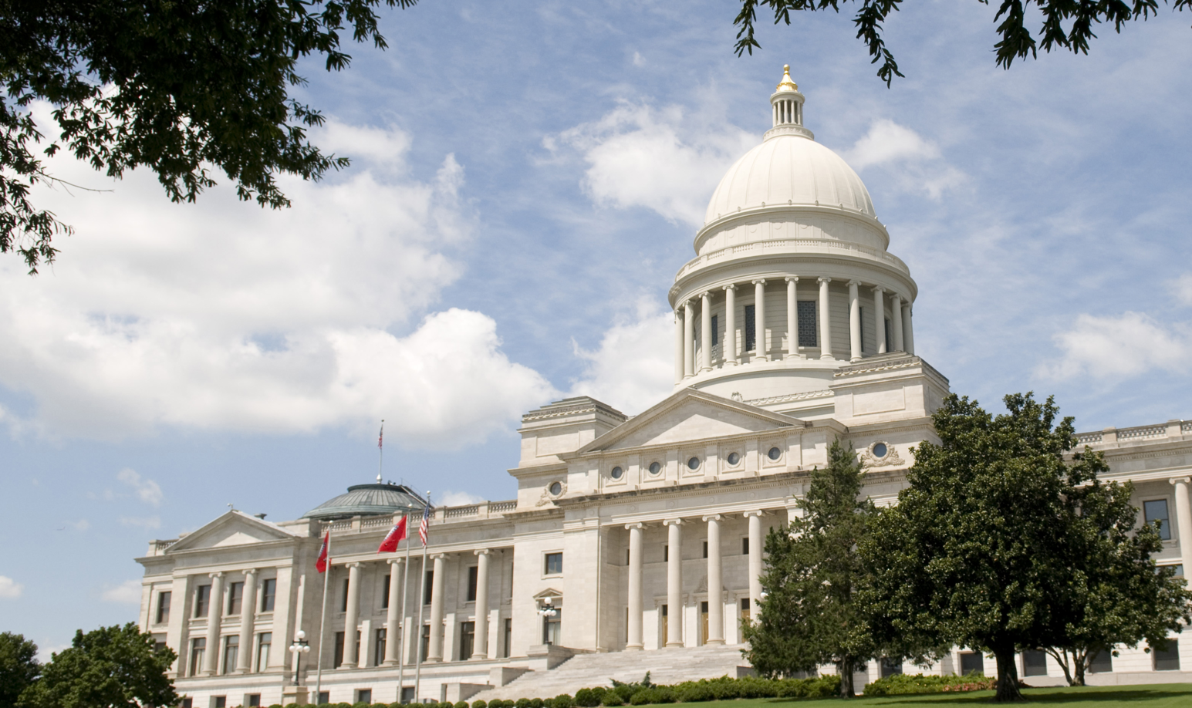
Notes:
State Board of Finance Investment Operation and Returns, 3rd Quarter - 2019

